Slide 1

St Stephen Churchtown Academy
Every pupil matters;
every moment counts!

Slide 2
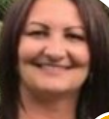
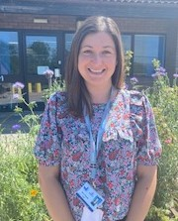

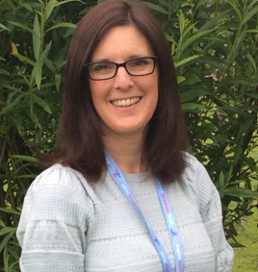
Meet our school team
Mrs McGinty
Head of School
Mrs Ridpath
Assistant Head of School
Sarah Chown
Parent Support Advisor
Mrs Mullin Reception Teacher / EYFS lead

Slide 3
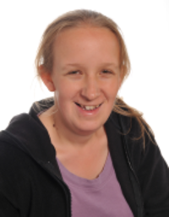
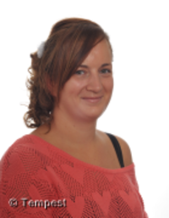

Meet our sEND team
Mrs Ellis
School SENDCo teacher
Mrs Geach
School SENDCo assistant
Miss Motherwell
ASD Champion

Slide 4
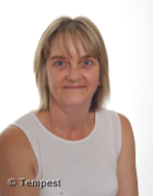
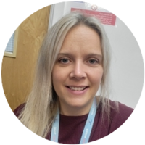
Meet our office team
Mrs
Pethick
Miss
Warne

Slide 5
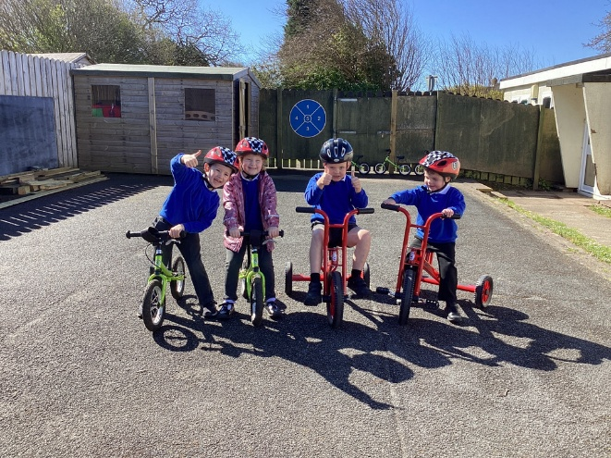
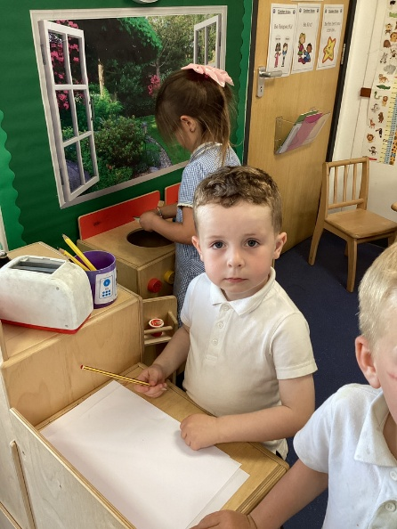
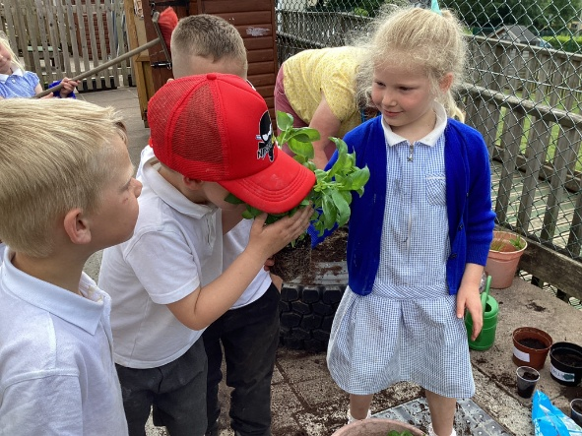
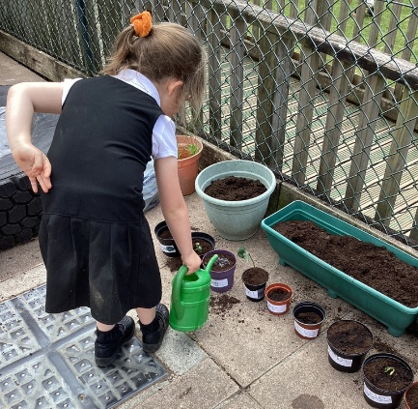
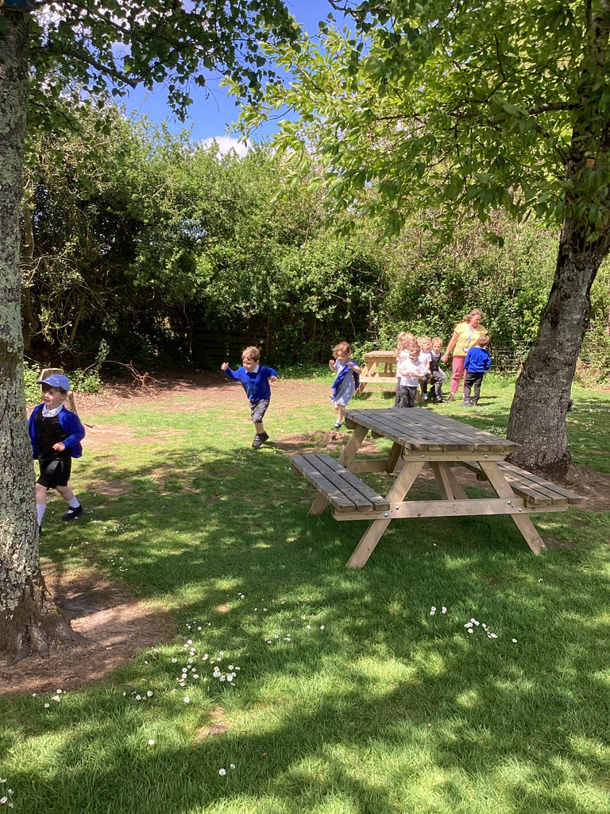
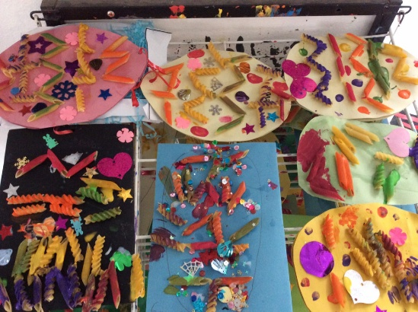
Early years Foundation stage
(EYFS)
Our Philosophy in EYFS
Making every moment count to unlock a lifetime of opportunities.

Slide 6
Early years curriculum
Three Prime Areas:
Personal, Social and Emotional Development
Communication and Language
Physical Development
Four Specific Areas:
Literacy
Mathematics
Understanding the World
Expressing Arts and Design

Slide 7
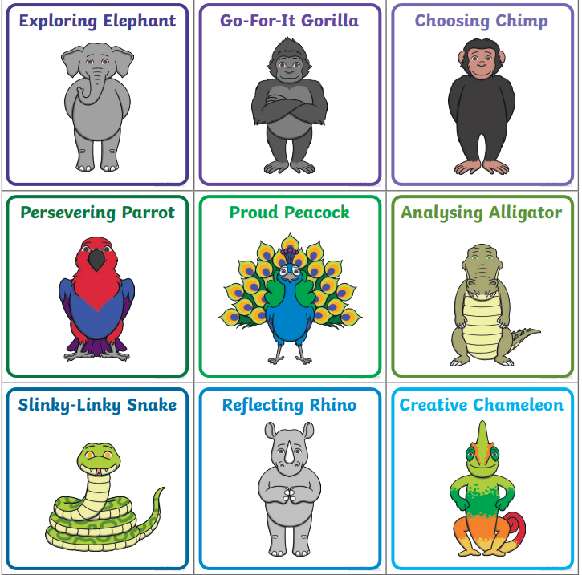
Characteristics of effective Teaching and learning
Characteristics of Effective Teaching and Learning (CoETL) are in the Early Years Foundation Stage Curriculum (EYFS).
CoEL reflect on the different ways that children learn.
Playing and exploring - children investigate and experience things, and ‘have a go’;
Active learning - children concentrate and keep on trying if they encounter difficulties, and enjoy achievements; and
Creating and thinking critically - children have and develop their own ideas, make links between ideas, and develop strategies for doing things
Notes:
The Characteristics of Effective Learning describe behaviours children use in order to learn. To learn well, children must approach opportunities with curiosity, energy and enthusiasm. Effective learning must be meaningful to a child, so that they are able to use what they have learned and apply it in new situations. These abilities and attitudes of strong learners will support them to learn well and make good progress in all the Areas of Learning and Development.

Slide 8

TAPESTRY
Parents will receive information about their child’s development through Tapestry, which links to the EYFS framework.
If new to Tapestry, you will receive an email to activate your account.
Notes:
Tapestry is an online journal to help record all the learning and fun of children's early years education.

Slide 9


Slide 10
The school day
8.50 School day starts. Drop off outside area of Reception.
10.10 – 10.30 Morning break with milk/water and fruit snack provided by school.
Free milk until their 5th birthday.
12.00 – 1.00 Lunchtime
Free hot school meal or healthy packed lunch (drink bottle)
Hot school meals to be booked through ParentPay.
3.20 School day ends.

Slide 11

School dinners

Slide 12
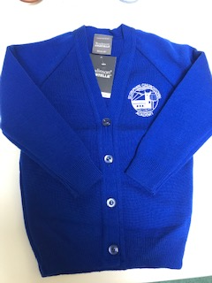
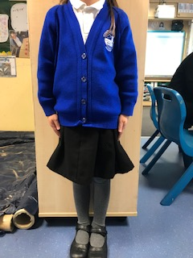
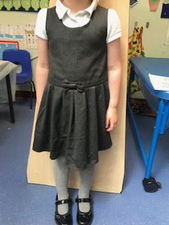
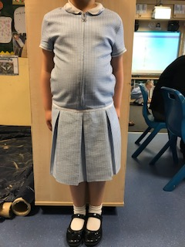
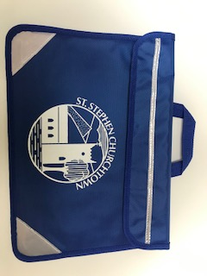
School uniform
Girls www.cornwallscreenprint.co.uk

Slide 13
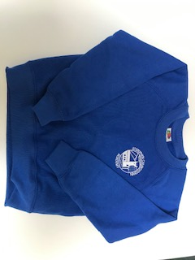
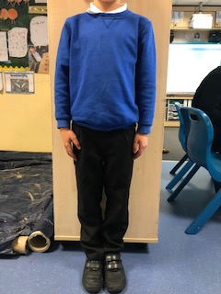
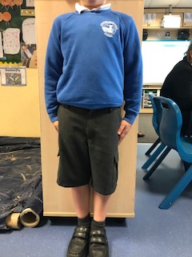
School uniform
Boys www.cornwallscreenprint.co.uk

Slide 14
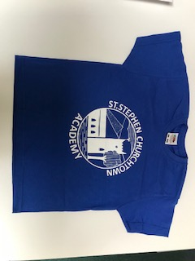
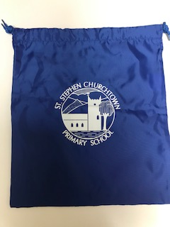
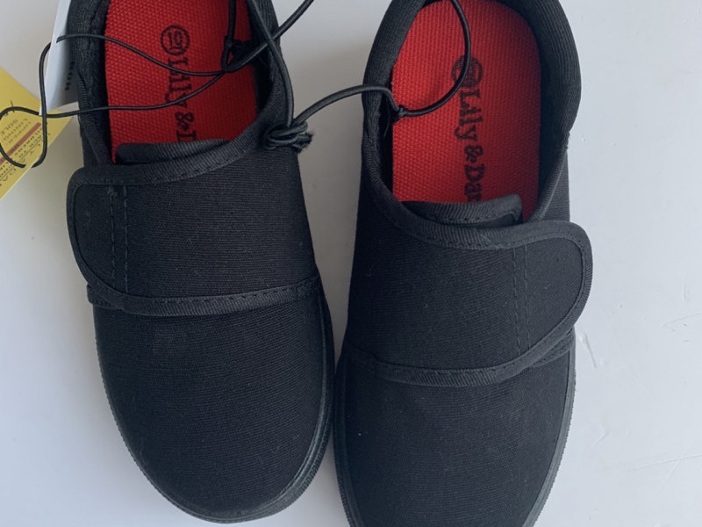
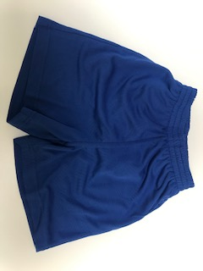

p.E kit

Slide 15
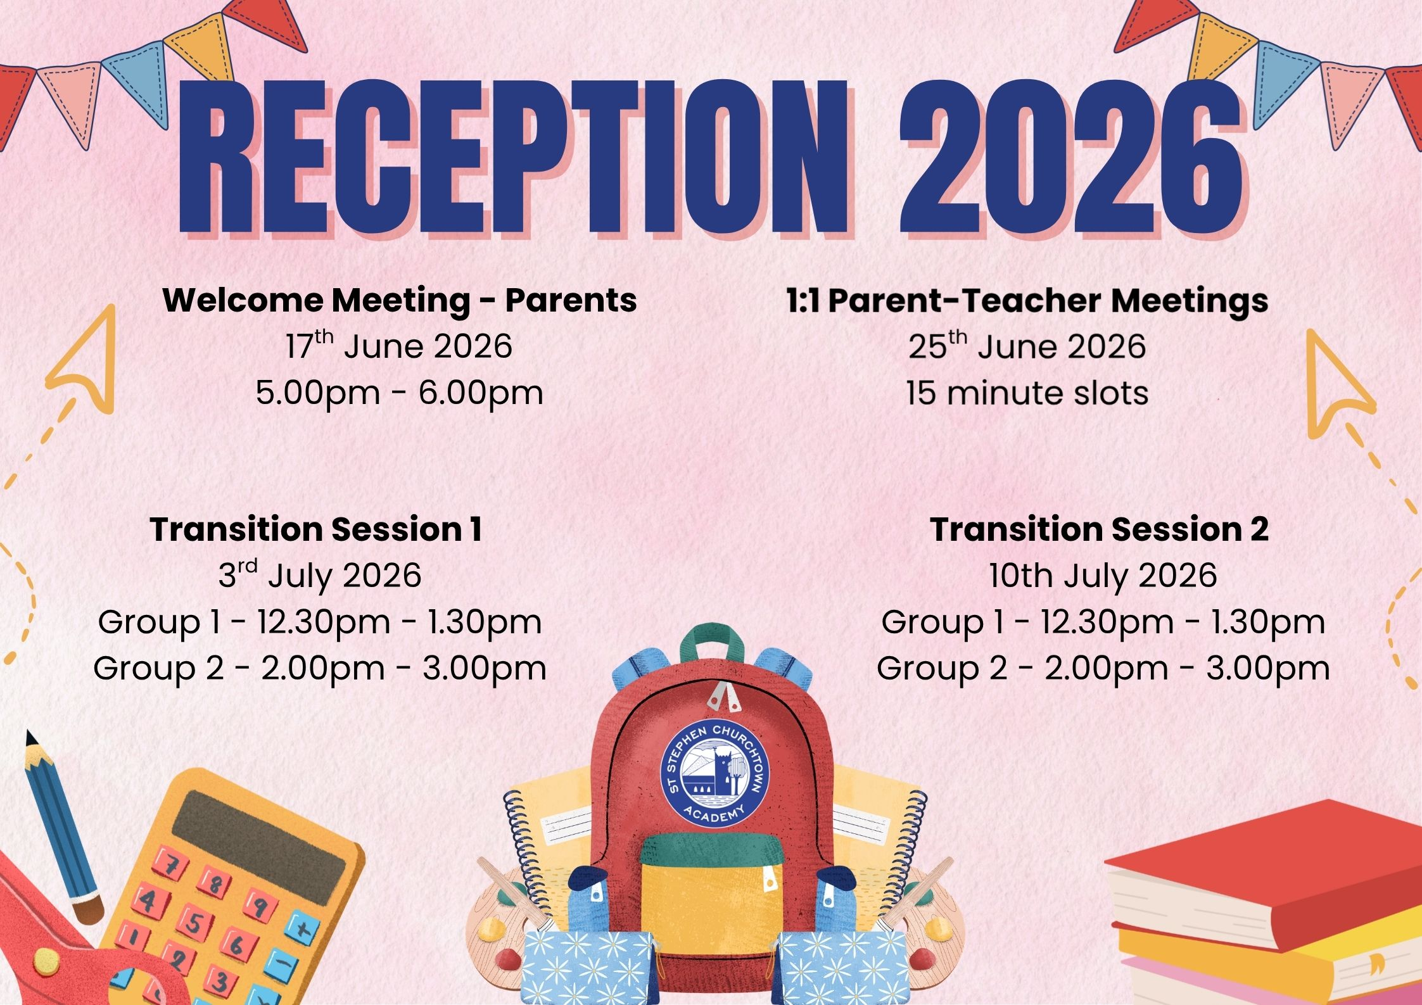
Important dates
1:1 parent / teacher meetings – 25th June all day
Transition 1 – 3rd July
Transition 2 – 10th July
Start school – Monday 7th September

Slide 16
Welcome Packs
1. Transition letter with timings for Stay and Play and September dates
2. Calendar dates for school year 2026/27
3. Breakfast club / After school club information
4. Letter formation using Little Wandle
5. Stages of pencil grip
6.. Number game with number formation – dice and whiteboard pen
7. Tapestry
8. Toothbrush and paste
9. READY for school / toilet training
10. Health Care Plan – please return this form with any medical information
(including asthma)
11. Tapestry information /consent
Free School Meals and Pupil Premium (link to be sent)

Slide 17


When does reading begin?
Parent phonic & reading meeting in September.
All children will begin with a non-word reading book during the first few weeks until first group of sounds have been taught.
Children are encouraged to share their school reading book at home daily.
Yellow reading records. Parents to record regularly when they read at home.
Children will receive a weekly Library book to share at home.

Slide 18
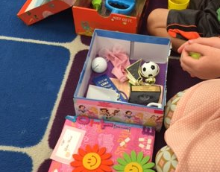
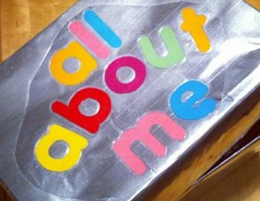
All about me
To begin our new topic we would like your child to create a box filled with objects which tells us about them. This could include:
Special photographs
A favourite book / toy
Special pictures / paintings / crafts
Postcards / pictures of special places
Please bring into school during the first few days and we will keep them in class for the half term.

Slide 19
September
Welcome back on Monday 7th September
Children need to bring:
- Backpack with spare clothes
- P.E kit in school PE bag
Book bag
Water bottle
Packed lunch - unless having a hot school dinner
Wellingtons
‘All About Me’ box
PLEASE NAME EVERYTHING!
Notes:
Reading and writing begins in earnest at the end of September/beginning of October. We begin with teaching the children their phonic sounds using jolly phonics which uses songs and actions to support the learning. The songs are available on CD or online.
It also helps if you sing these and nursery rhymes at home too.

Slide 20

stay in touch
School website
St Stephen Churchtown Academy - Home
Weekly Newsletters
School Facebook page
Emails / Texts
Notes:
Reading and writing begins in earnest at the end of September/beginning of October. We begin with teaching the children their phonic sounds using jolly phonics which uses songs and actions to support the learning. The songs are available on CD or online.
It also helps if you sing these and nursery rhymes at home too.

